Slide 1
VDC Cluster Analysis with APEX Data
May 28th, 2019
Emily Lyon
Tabb High School, Yorktown, VA
Ole Hansen
Jefferson Lab

Slide 2
APEX Overview
e¯
HRS-L
HRS-R
Search for "dark photons" ("Aʼ ")
Measured e⁺e¯ in coincidence
High luminosity -> high rates, especially in left arm spectrometer
Goal of this study: Get a feeling for how well the VDC cluster reconstruction works with those high rates
P_{L}=-1.063GeV/c
Singles rate: 400 kHz
e¯
e⁺
P_{R}=+1.063GeV/c
Singles rate: 50kHz
target
“2.8 % W”
e¯
50uA

Slide 3
Wire Chambers and Clusters
Cluster
θ
Track reconstructed by fitting a straight line to the distances derived from drift time

Slide 4
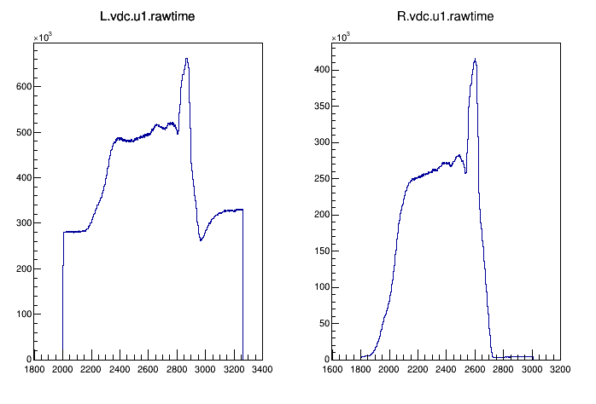
VDC Raw Time Spectra
Because of the high rate in the spectrometer, there is a much higher chance of accidental coincidences (more than one track per trigger)
Secondary tracks often arrive out of time with respect to trigger
HRS-L raw time spectrum shows clear evidence of out-of-time signals!
Some oddities in the time spectra
odd bumps
Dip
excess on edges

Slide 5
Improving the VDC Cluster Fit
Current two-parameter algorithm assumes a time offset of zero
Cannot tell if a result is out of time
Clusters for out-of-time tracks are not correctly fitted (wrong slope)
Question is – how does one analyze multi-track events? We need to eliminate secondaries
Solution: We need a three-parameter fit that fits a possible time offset of the cluster drift times
Main complication: there is a non-linear relation between the drift time and drift distance, so we need a non-linear fit
We wrote this fit in Python using scipy.optimize.curve_fit

Slide 6
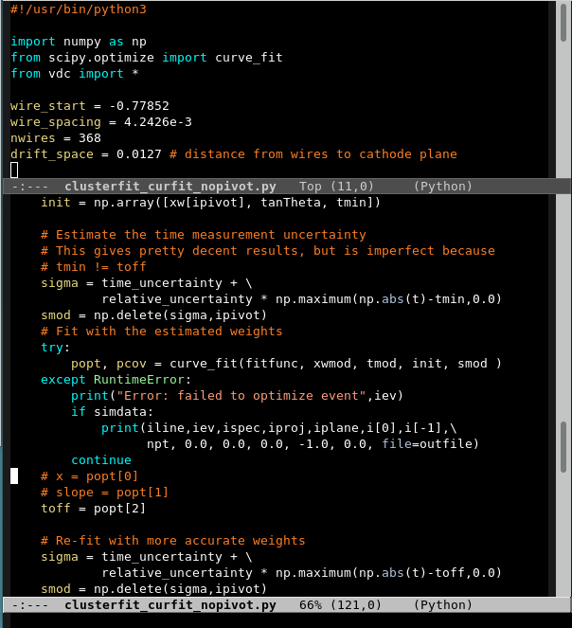
Here’s a snippet of our code ☺

Slide 7
Testing the Non-Linear Cluster Fit
Made a Python simulation that generated clean data
The simulation uses the time resolution and track angle distributions from the VDC NIM paper [1]
Found that the fit works well, but it is only stable when we omit the middle wire (wire with the smallest drift time)
Because we are omitting the middle wire, we need clusters with at least five wires
[1] K. G. Fissum, et al., NIM A474, 108 (2001)

Slide 8
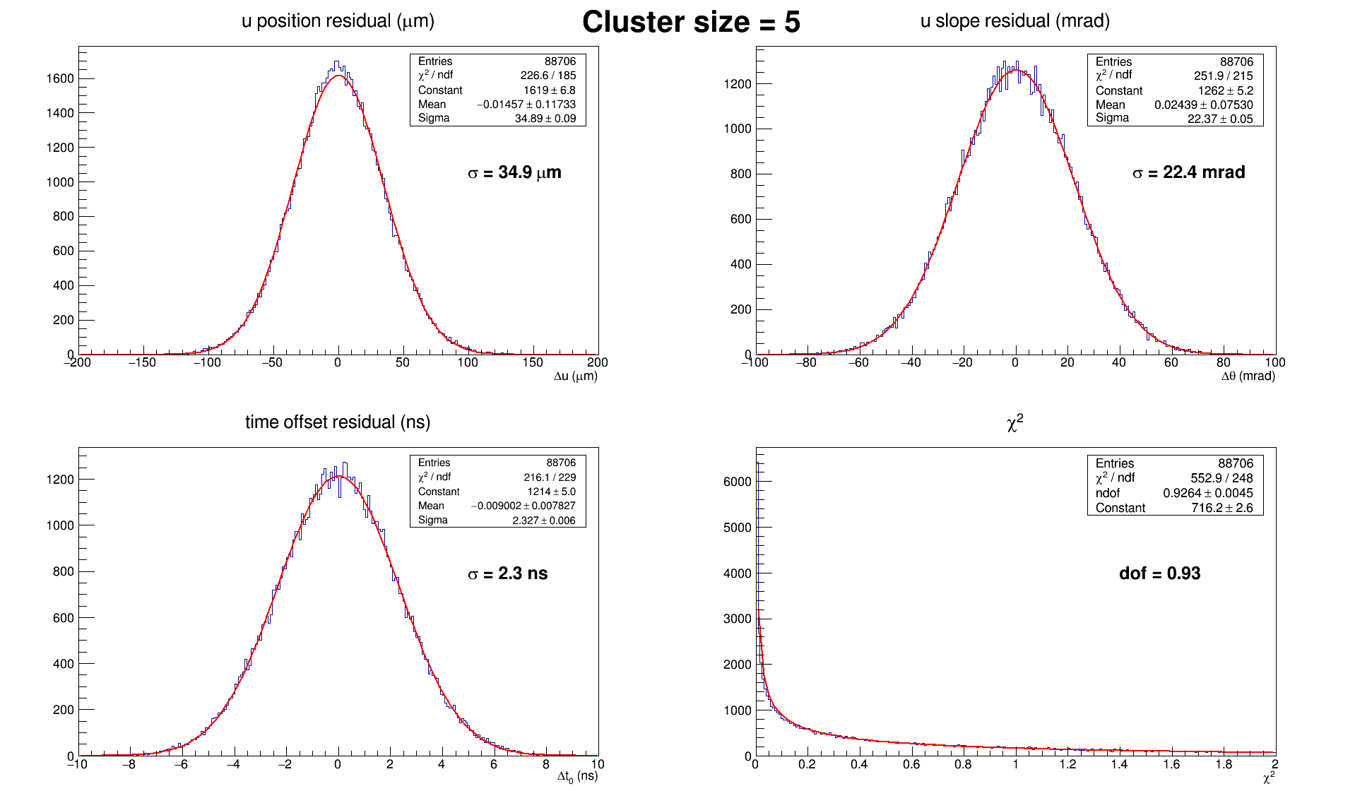
Results with simulated data (n=5)

Slide 9
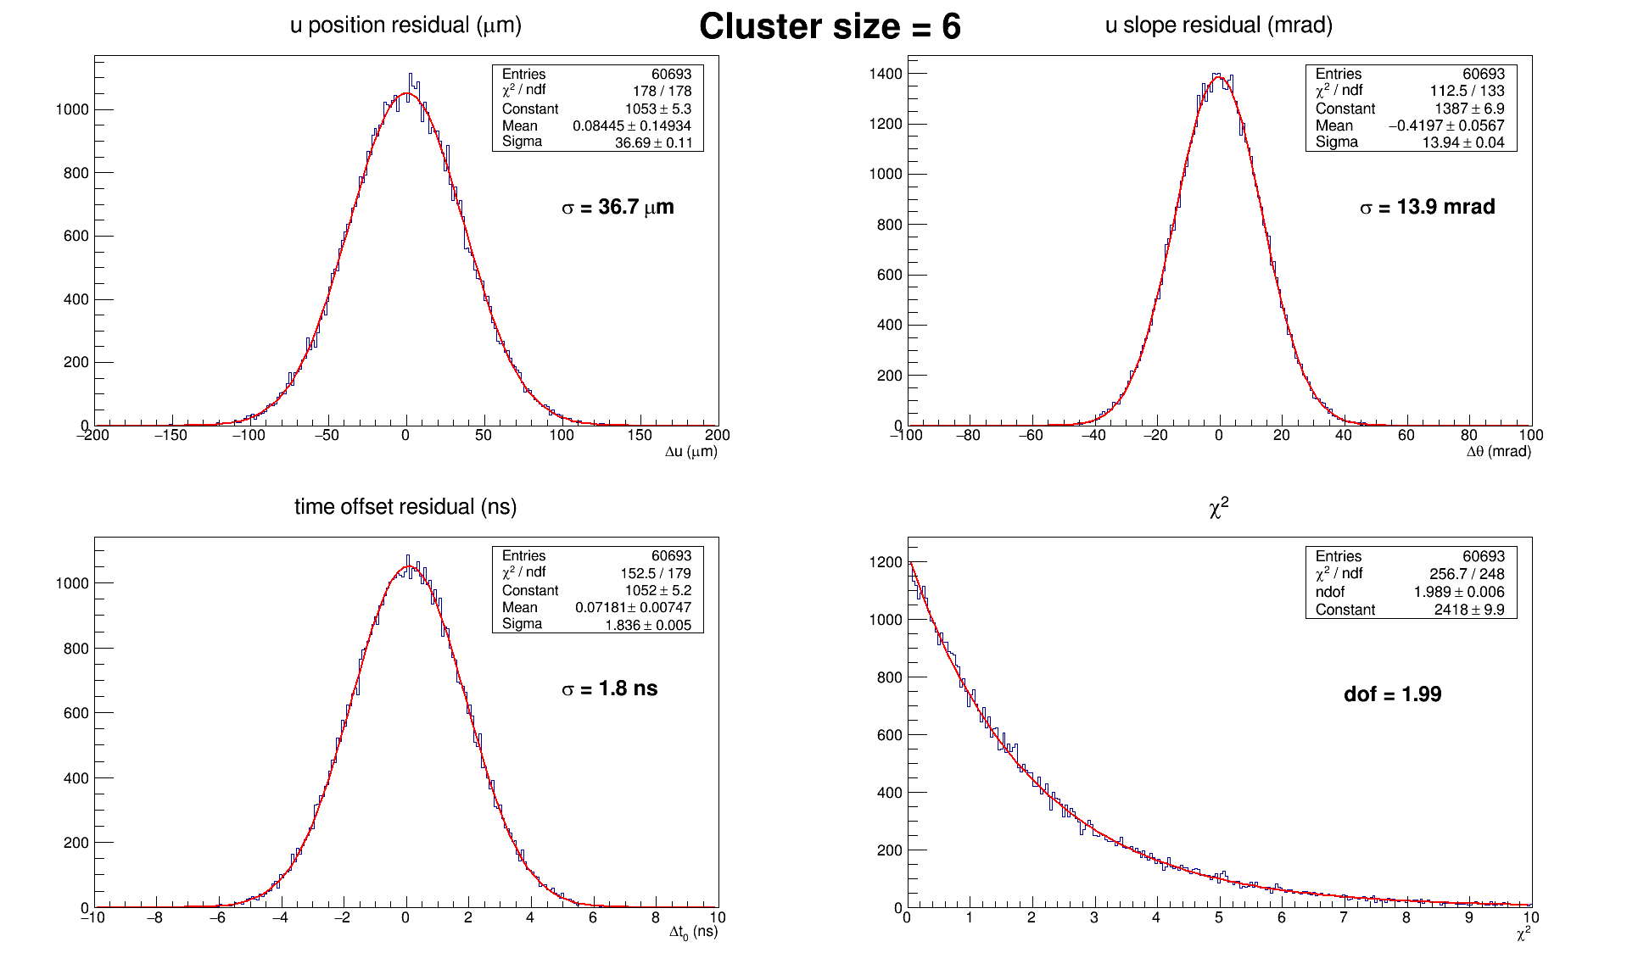
Results with simulated data (n=6)

Slide 10
Using Real Data
Got VDC data from Run #4976 (production run, 3/17/19)
Hacked standard analyzer to write out cluster data to a text file
Used the TDC offsets from the online replay database
It worked!
However, we found unusually large time offsets so we had to redo the TDC offset calibration (existing calibration was rough)
3-parameter fit is about 10-20x slower than existing 2-parameter fit

Slide 11

Python Simulation
mkrootfile
Root
Script
Root
file
Python Script 3-parameter Fit
Text
file
Root
Text
file
hack
C++ Analyzer
Interactive
Analysis
Real raw data
Root
file

Slide 12
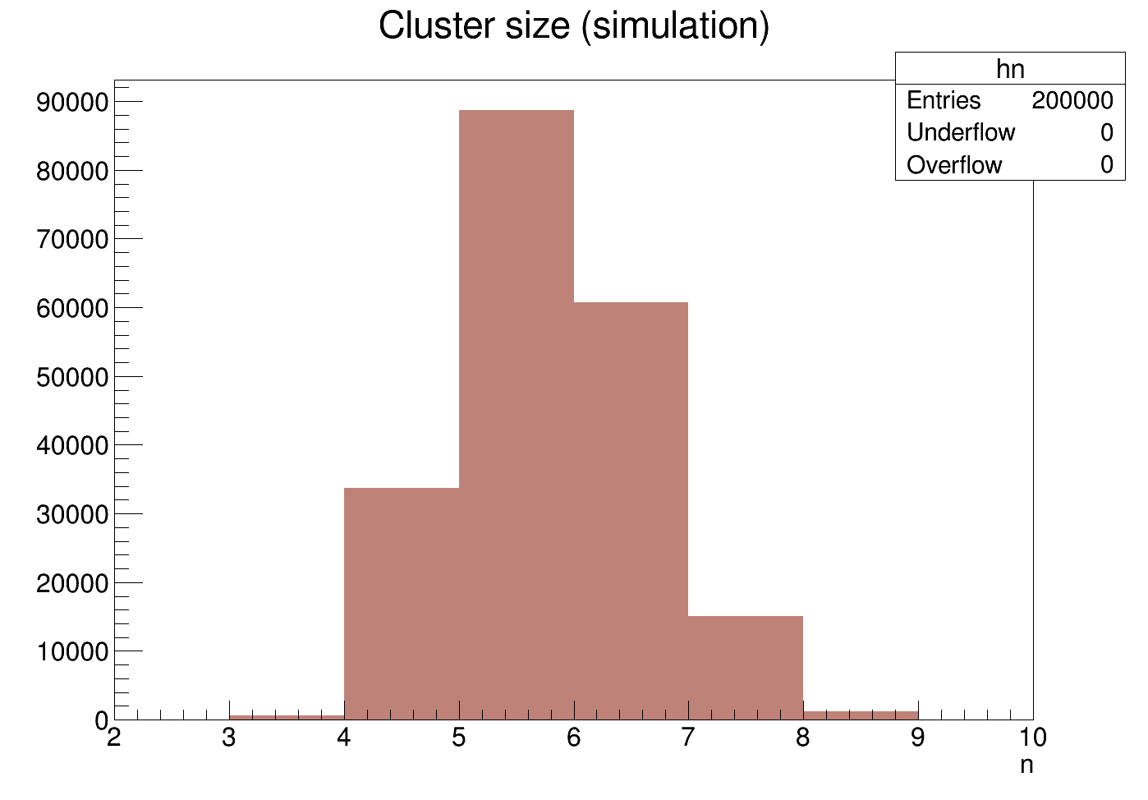
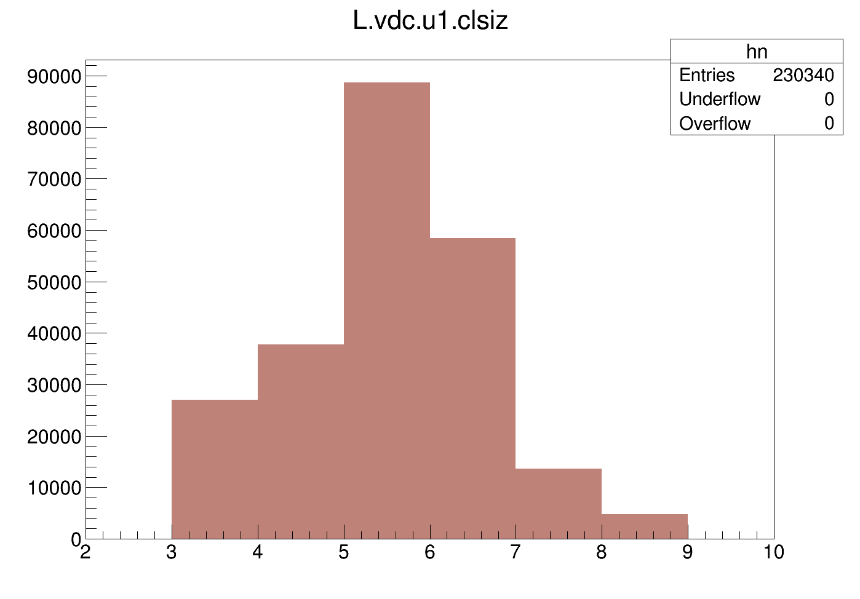
Cluster Size: Simulation vs. Real Data
Cannot be analyzed with 3-parameter fit

Slide 13
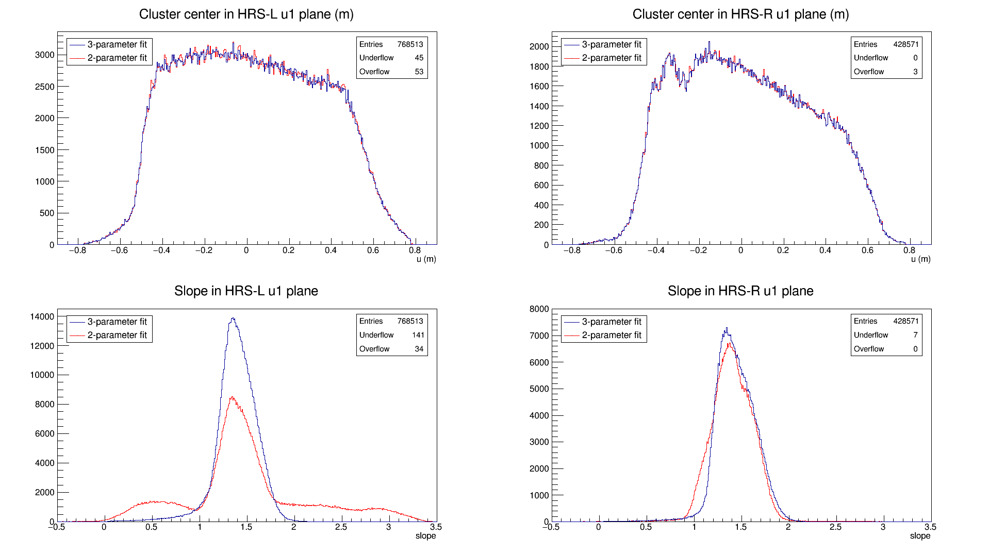
3-parameter fit corrects bad slopes
Notes:
Note: time resolution of 6ns
Note: we also tried out a time of flight correction but found that its impact is negligible

Slide 14
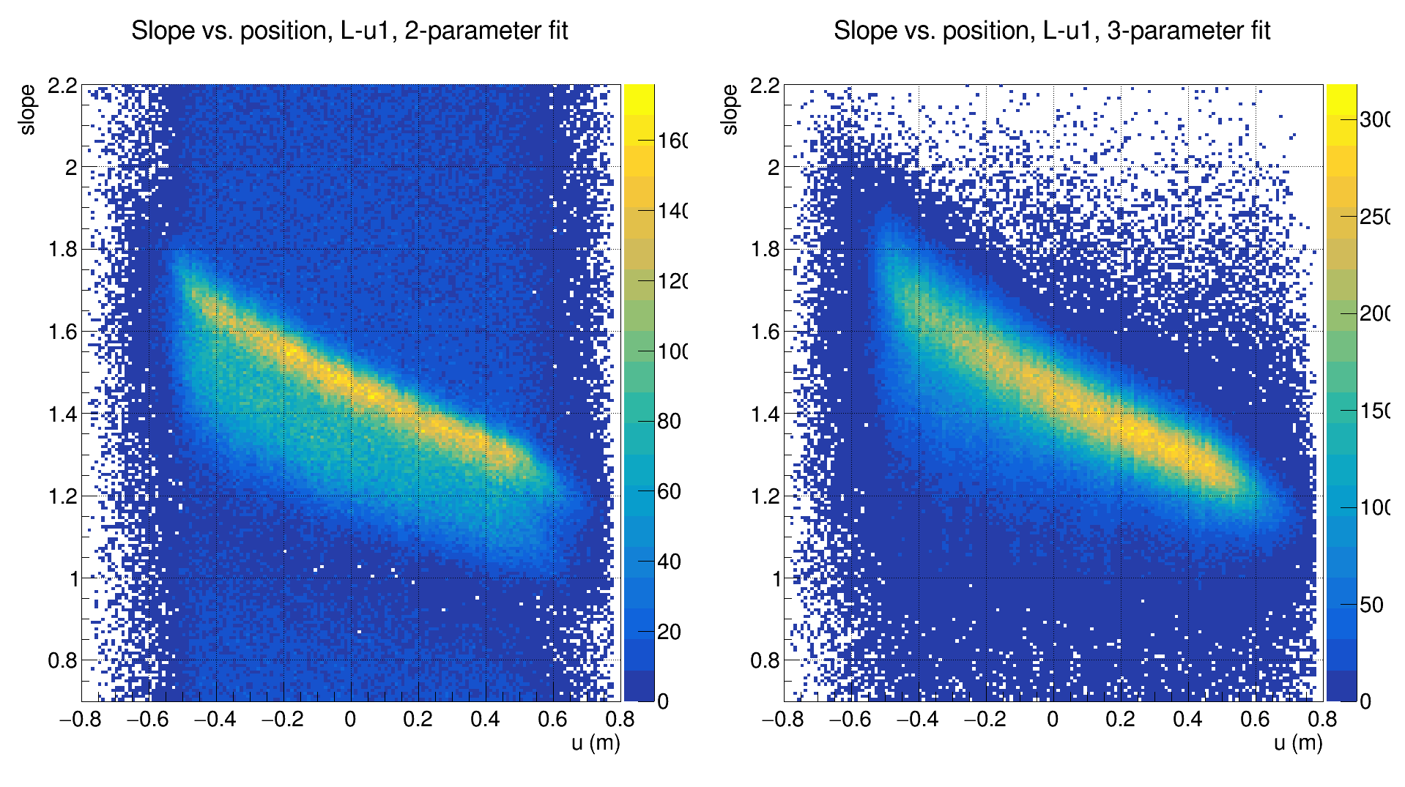

Slide 15
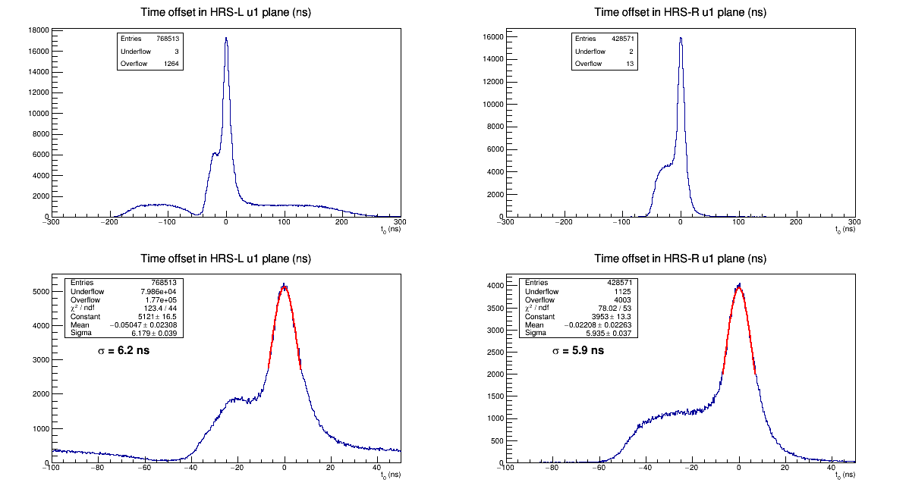
These long tails are out-of-time tracks
yet to understand this shoulder

Slide 16
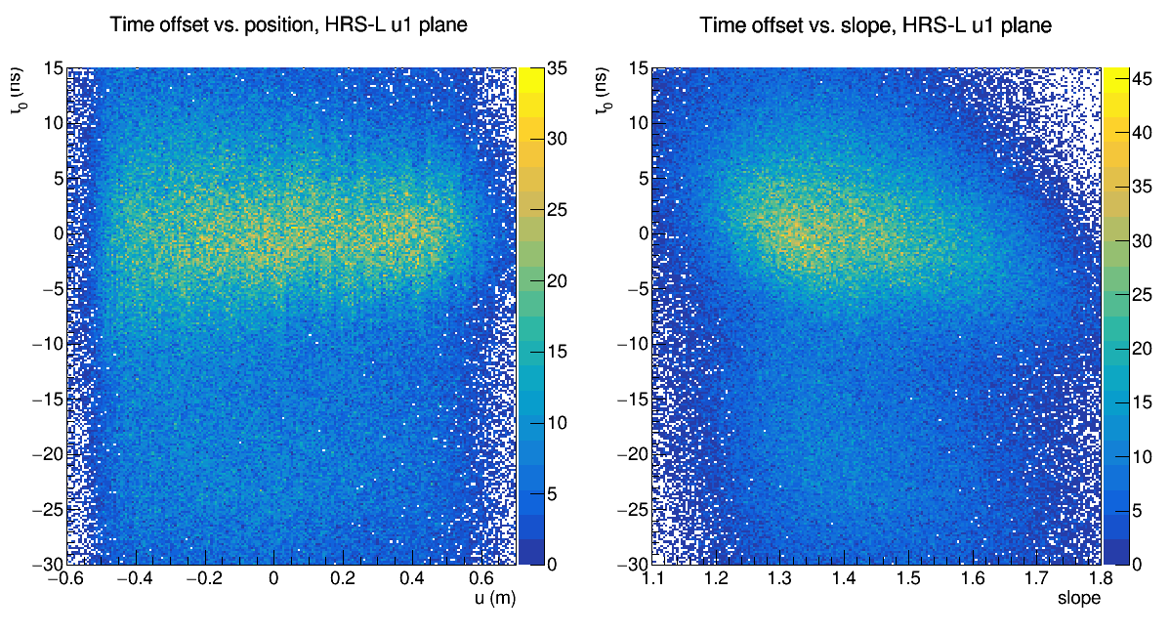
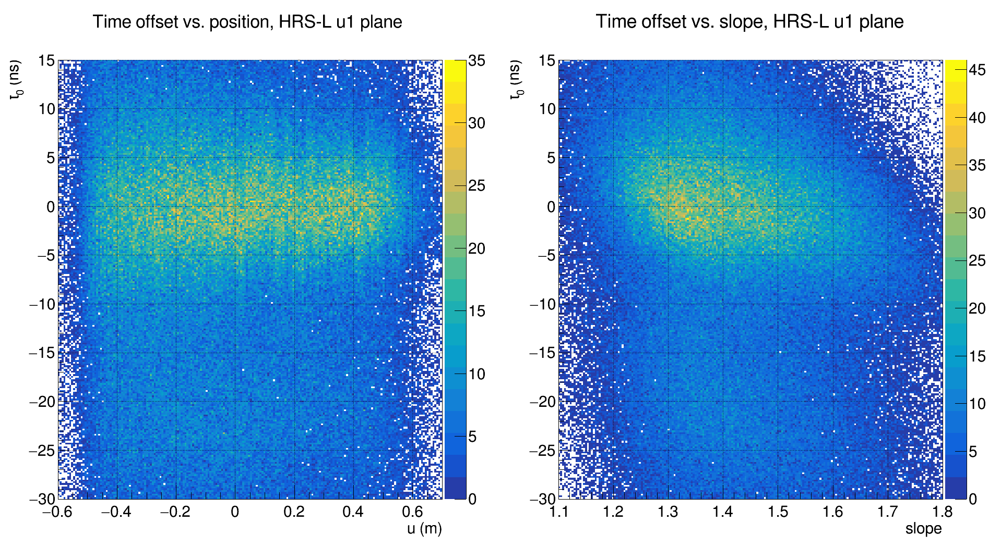
correlation? Could time to distance conversion be responsible?
nanosecond-level jumps because of imperfect calibration
Notes:
Point out jumps, but those are explained by imperfect calibration
Move on to slope, you would expect a correlation because of time of flight, but TDC calibration mostly takes care of that and we added a time of flight correction but it had very little impact, so we don’t understand why this correlation exists.

Slide 17
Conclusions
Our fit works
Cluster time offsets have 6 nanosecond time resolution
Still some unsolved questions:
Raw time spectrum has unusual bumps
Shoulder in the time offset plot at -30ns
Time offset has slight inverse correlation with slope
Next steps
Put the three-parameter fit algorithm into the main analyzer
Check the time to distance conversion
Modify the main analyzer’s track reconstruction to take advantage of the time offset information

